Slide 1

How to Build Effective BIPs – Sharing best practices
Blended Intensive Programmes (BIPs)
  Prof. Grzegorz Lesiuk
  grzegorz.lesiuk@pwr.edu.pl
  Mrs. Anna Iwanowska
  Anna.Iwanowska@pwr.edu.pl

Slide 2
  Agenda:
  Concept of BIPs
  Case Studies from Wrocław University of Science and Technology
  Final conclusions
  Discussion

Slide 3
What is a BIP?
A Blended Intensive Programme (BIP) is a short, innovative course combining:
Physical mobility (5–30 days)
Mandatory virtual component (before, during, or after the on-site part)
BIP provide added value beyond standard curricula, include specialised content,
and promote transnational teamwork and online collaboration.
Open to students, PhD candidates, teaching and administrative staff.
Programmes may involve mixed groups (students + staff) if justified by the learning objectives.

Slide 4
Requirements & Systems
Core requirements (Erasmus+ 2026):
Minimum 3 institutions from 3 Erasmus+ programme countries
At least 10 participants (recommended 17+ to secure final number)
Participants from non-EU Partner Countries may join but do not count towards the minimum, the same as teaching Staff or hosting institution students.
Award of minimum 3 ECTS
Inter-Institutional Agreement or multilateral agreement
Hybrid teaching: online + on-site
Registration systems:
Beneficiary Module (BM):
  Registration of the BIP activity
  Linking each mobility to the BIP ID
  Uploading nomination lists, participant data, Learning Agreements, reporting
IRC (at Wrocław Tech):
  Used for participant nomination, internal approval workflow and documentation

Slide 5
Funding & Support
Costs
Budget should be coordinated across all partner institutions.
Coordinator’s eligible costs: venue rental, teaching materials, staff remuneration, social/cultural activities,
printed materials, welcome packs.
Travel & living costs for incoming students can be covered from sending institution’s Erasmus+ budget.
(Important to avoid double funding).
Income Sources
Erasmus+ grant: 400 EUR per incoming participant. Maximum: 6000 EUR. 4000 EUR = 10 participants.
Partner institutions’ contributions
Sponsors
Co-financing. Own contribution encouraged.
Support & Admin (at Wrocław Tech)
CRM provides formal verification of documentation, partner-agreement support, and budget verification.
Project & participant data management in required systems. Advises on cultural programming, event logistics,
and handles student mobility reporting.
Next Erasmus+ cycle: planned call for 6 new BIPs./ Info meeting for academic staff coming soon.

Slide 6
How to prepare & deliver a successful BIP
Find reliable partners and define: teaching staff, numer of participants, number of ECTS to be awarded.
Co-create course content and online modules; ensure student collaboration online
Recruit at least 17 participants (or more) to secure attendance
Plan realistic logistics within the budget.
Ensure clear distribution of tasks across the consortium
Use BM and IRC consistently for: nominations, participant registration, Learning Agreements, and reporting
Provide strong academic content, cultural programme for full learning impact and integration activities

Slide 7
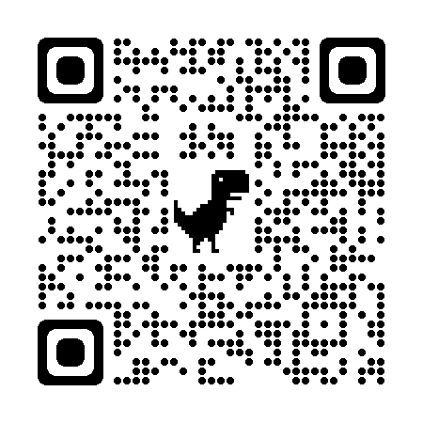
List of BIP’S
Free Database:
https://erasmusbip.org
https://erasmusbip.org/list-of-bips/
‘Last Minute, help us get 15 participants in time’
‘Open for All (new applicants and new IIA welcome)’
‘For now open for invited partners only. (subject to change, contact BIP Coordinator)’
Useful publications:
Good practices in the implementation of the virtual component of blended intensive programmes (BIPs)’
Blended mobility implementation guide for Erasmus+ higher education mobility KA131
Link to the Blended Intensive Programme website for Wrocław Tech employees, practical information

Slide 8
What is BIP?
  Blended
  A mix of in-person and remote learning activities.
  Enabling flexible mobility formats, but necessarily combining
    a short-term mobility abroad
    a compulsory virtual component that brings the learners together online to work collectively and simultaneously on specific assignments.
  Intensive
  Short activities : between 5 and 30 days
  Single trip (two distinct weeks are not possible)
  Programme
  Erasmus+ programme has to meet all Erasmus+ procedures:
  interinstitutional agreements, learning agreements,
  transcript of records, recognition of credits, and more.

Slide 9
Capacity Building in HE Project (CBHE) | Blended Intensive Programme (BIP)
Needs a third country partner (Opportunity for a non European partner!)
Includes (3-year base): courses and design project preparation, 2 years of students projects (mobility included) | Includes: collaborative design project mobility (5-30 days)
Budget for activities and mobility (400 – 800 k€) | Budget for mobility 75 € / day (student) + travel excluded from grant Budget for organization 400 € / participant (max. 20 participants)
Period covered (if accepted) : 3 years 15th Nov 2024 – 15th Nov 2027 | Period covered 15th Sep 2024 – 15th Nov 2025
4 HEIs at least | Number of students/participants in [15,20] 3 HEIs at least 3 ECTS credits for students
Inclusion of industry more visible

Slide 10
Schedule
  Concept of BIPs
  Case Studies from Wrocław University of Science and Technology
  Discussion
  Final conclusions

Slide 11



WROCLAW TECH – RECENT BIP EXPERIENCE
Title of the BIP hosting by WUST:
Construction, operation and diagnosis of rail transport equipment
(3 countries, 17 participatns)
Wrocław University of Science and Technology, Poland
Vilnius Gediminas Technical University, Lithuania
Univeristy of Zagreb, Croatia

Slide 12
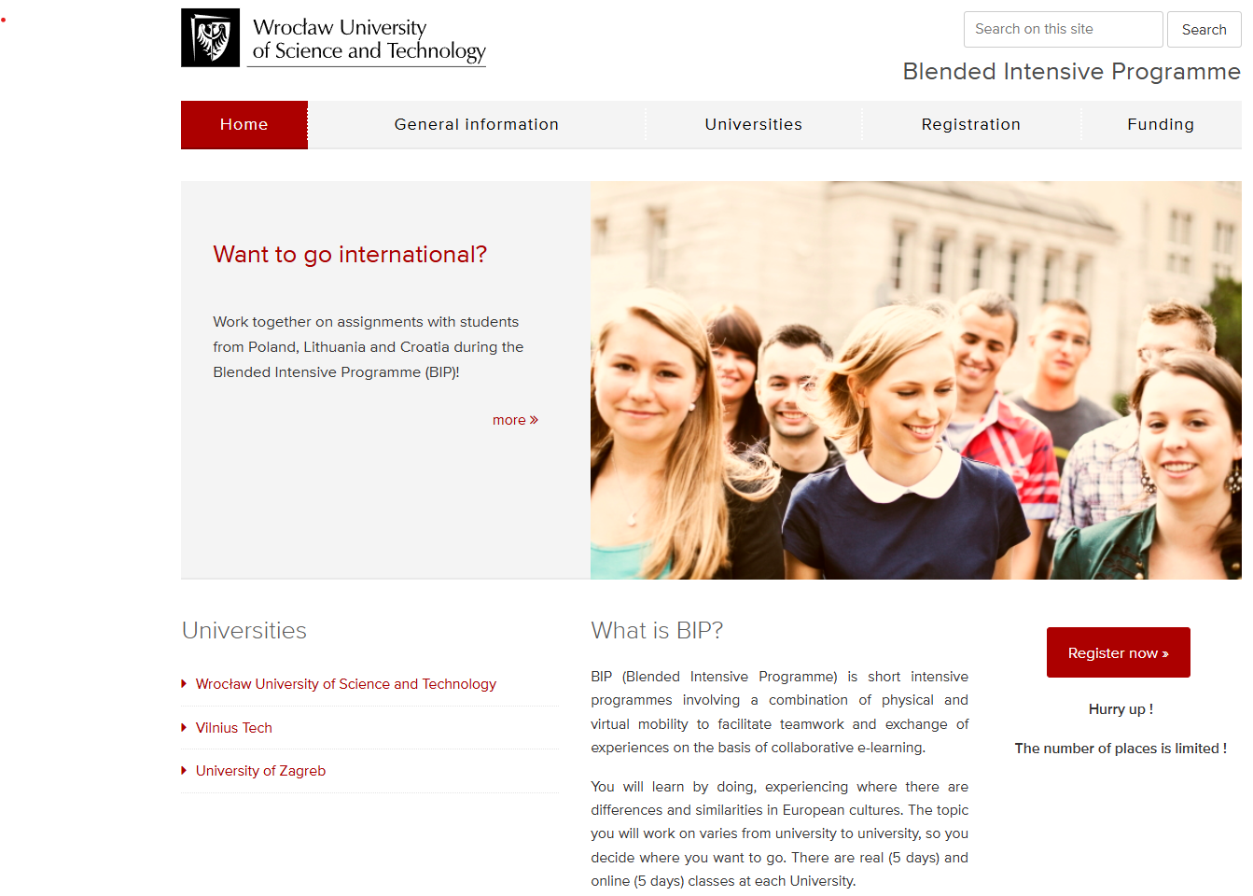

Slide 13
General information
During the programme, groups of students/doctoral students and/or staff may undertake short-term physical mobility abroad combined with a compulsory virtual component.
The virtual component must provide a space for learners to work together and simultaneously online on specific tasks that form part of a blended intensive programme and contribute to the overall learning outcomes.
Types of mobility:
physical - going abroad to the country of the organising university to complete the agreed BIP, minimum length of stay is 5 days and maximum is 30 days, not including travel days;
virtual (remote) - implementation of a virtual BIP which takes place remotely only outside the country of the organising university and enables teamwork and exchange of experience on the basis of e-learning.
BIP @ Wrocław University of Science and Technology
When:
  24.04.2023 - 28.04.2023 (real)
  02.05.2023 - 06.05.2023 (on-line)
Where:
  Faculty of Mechanical Engineering
Registration deadline:
  14th of April 2023

Slide 14
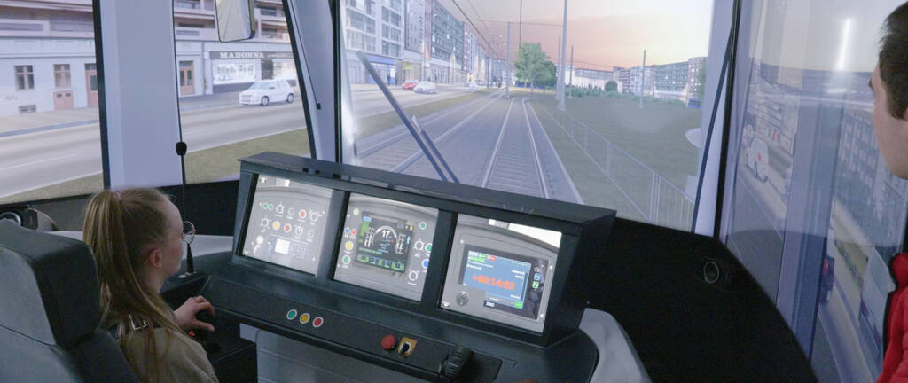

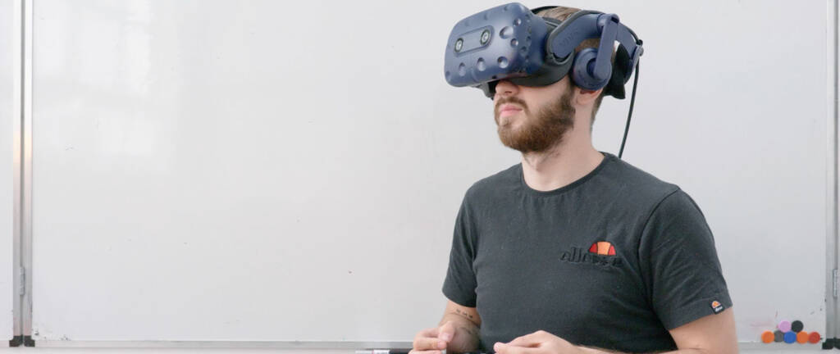
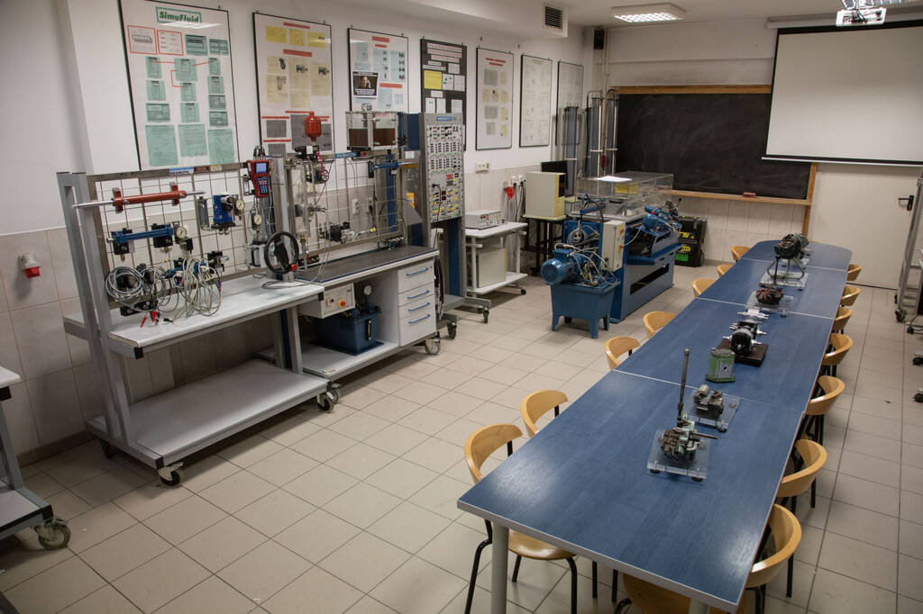
Construction, operation and diagnosis of rail transport equipment
During theoretical and practical classes, students will be introduced to the problems of construction, operation and diagnostics of rail transport means. Issues of safe operation and malfunction diagnosis of transport system components will be presented. Students will be introduced to contemporary testing and diagnostic methods. Students will acquire knowledge in the construction of means of transport, operation and fault diagnosis using dedicated modelling methods and testing tools.

Slide 15
Registration
Explore Wrocław University of Science and Technology. Registration starts from the 1st of March and ends 14th of April 2023. Applications should be sent to bip-project@pwr.edu.pl. Below you will find a list of required information:
First name
Last name
E-mail address
University
Faculty
Field of study
Do you want to stay at the dormitory of the Wrocław University of Science and Technology ?

Slide 16
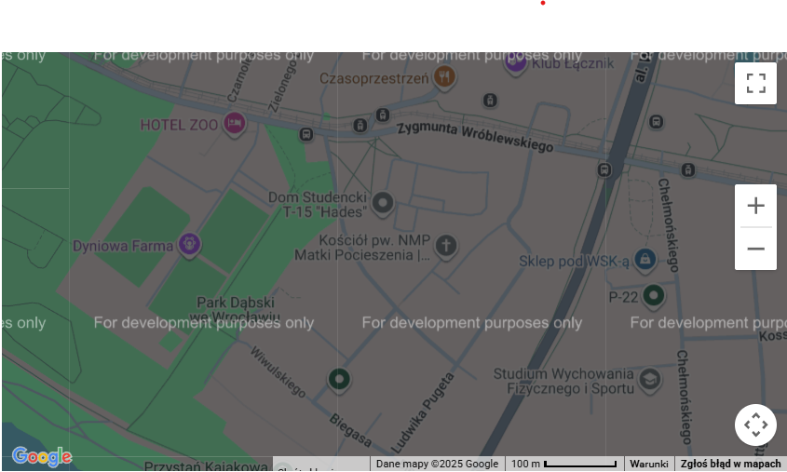
Student Dormitories
Our dormitories are situated within easy travelling distance of the university buildings. The range of facilities offered varies, but most dormitories have areas for study and recreation, kitchen facilities, laundry facilities, car parks and are a safe and friendly environment for you to live in. There are mostly double rooms in the dormitories. Bathrooms are shared by a few students. There are kitchens with cookers on each floor. You should bring your own towels and bedclothes. If you want to use the Internet in the dormitory, you should have your own PC/laptop. You can also use our computer laboratories with free Internet access in our campus, open 24 hours a day 7 days a week – in this case, you do not need your own computer. Near the dormitory there are grocery shops, a bus stop and a tram stop. Here you can find more information:
International Students Guide
Dormitories

Slide 17
PURPOSE AND GOAL
“Construction, operation and diagnosis of rail transport equipment” program is held in the form of a BIP because we want to give every student the opportunity to gather an experience with other international students. Virtual mobility is the only way to deal with the uncertainties and restrictions that COVID-19 has imposed on international student exchange and collaborations. During “Construction, operation and diagnosis of rail transport equipment” we will tackle these difficulties with a remote, but intense, online course. The program offers participants the opportunity to get acquainted with creative methods and techniques for safe operation and malfunction diagnosis of transport system components. Students will be introduced to contemporary testing and diagnostic methods and will acquire knowledge in the construction of means of transport, operation and fault diagnosis using dedicated modelling methods and testing tools.

Slide 18
Date (real, on-line).
24.04.2023 - 28.04.2023 (real)
02.05.2023-06.05.2023 (on-line)
What is expected (lectures, working in small teams, social activities).
Lectures in a pleasant atmosphere, laboratory working in international small groups, a city tour to discover the culture and history of the beautiful city of Wrocław, one of Poland's largest cities.

Slide 19
CERTIFICATE
Upon successful submission of the required post-course work, participants will receive a certificate. This certificate states the grade you have received in the „Construction, operation and diagnosis of rail transport equipment” course.

Slide 20
TEACHING METHODS
Students will participate in online and onsite lectures, which will be provided by carefully selected lecturers from international partnering institutions. In addition, creative and contemporary teaching and learning methods, such as problem-based learning, gamification, teamwork and project tasks, will be applied to establish a collaborative work environment and to enable students to learn from both lecturers and each other.

Slide 21
LEARNING OUTCOMES
During the training, students will have the opportunity to learn practical skills that can be applied in a future career related to railway infrastructure. The training will include both theoretical classes and practical workshops that will allow students to gain practical experience. Students will also be able to learn about the latest technologies and trends related to railway infrastructure, which may be helpful in their future work. All this will make students better able to understand and control the process of building, operating and diagnosing railway infrastructure devices.

Slide 22
INVITED LECTURES FROM PARTNERS (IN WROCLAW)
TEAM FROM LITHUANIA:
  Prof. Mykola Karpenko – Vilnius Gediminas Technical University, Lithuania
  Dr. Almantas Danilevičius – Vilnius Gediminas Technical University, Lithuania
TEAM FROM CROATIA:
  Dr. Tomislav Rožić – University of Zagreb, Croatia

Slide 23
DESCRIPTION
The training for students will consist of various topics related to replacement, operation and diagnosis of railway infrastructure devices. Below are some topics that can be an example of such training, e.g.:
Basics of the construction of railway tracks and infrastructure elements - discussion of various types of tracks, sleepers, turnouts and other elements of railway infrastructure. • Safety on the tracks - discussion of the rules of safety on the railway tracks, including the rules of working on the tracks, immediate procedures and others.
Rail Traffic Control Systems - an overview of various rail traffic control systems, such as track block systems, traffic light systems, and more. • Railway shunting devices - discussion of various shunting devices, such as shunting locomotives, rail crossings and others.
Diagnostics and maintenance of electrical devices - methods of diagnosing and operating optical devices, such as systems for monitoring devices and optical devices.

Slide 24
VIRTUAL COMPONENT
The online part of the proposed program will include a combination of lectures, case study analyses, individual and team work assignments. Participation in all scheduled appointments will be obligatory, as well as working on all assigned tasks. Students will form international teams, preferably composed from different study profiles and fields working towards an innovative and sustainable digital solution of a real case problem. All virtual classes and homework will prepare the student teams for the final physical week, in which they will get acquainted with a real-life organization, its problems and challenges, that they will try to find and propose a solution for. The virtual classes will be supported by an online training platform as well as through an online collaboration tool Zoom for easy online communication between team members, all students and teachers.

Slide 25
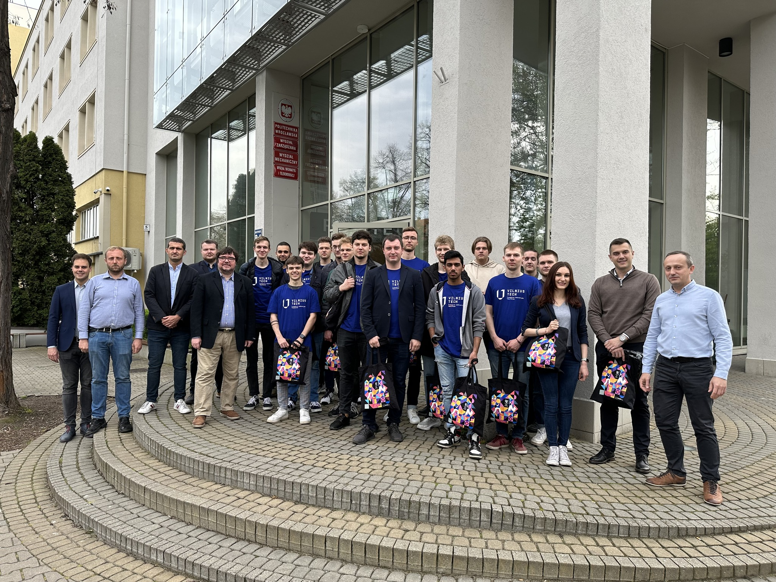
BIP Memebers at WUST

Slide 26
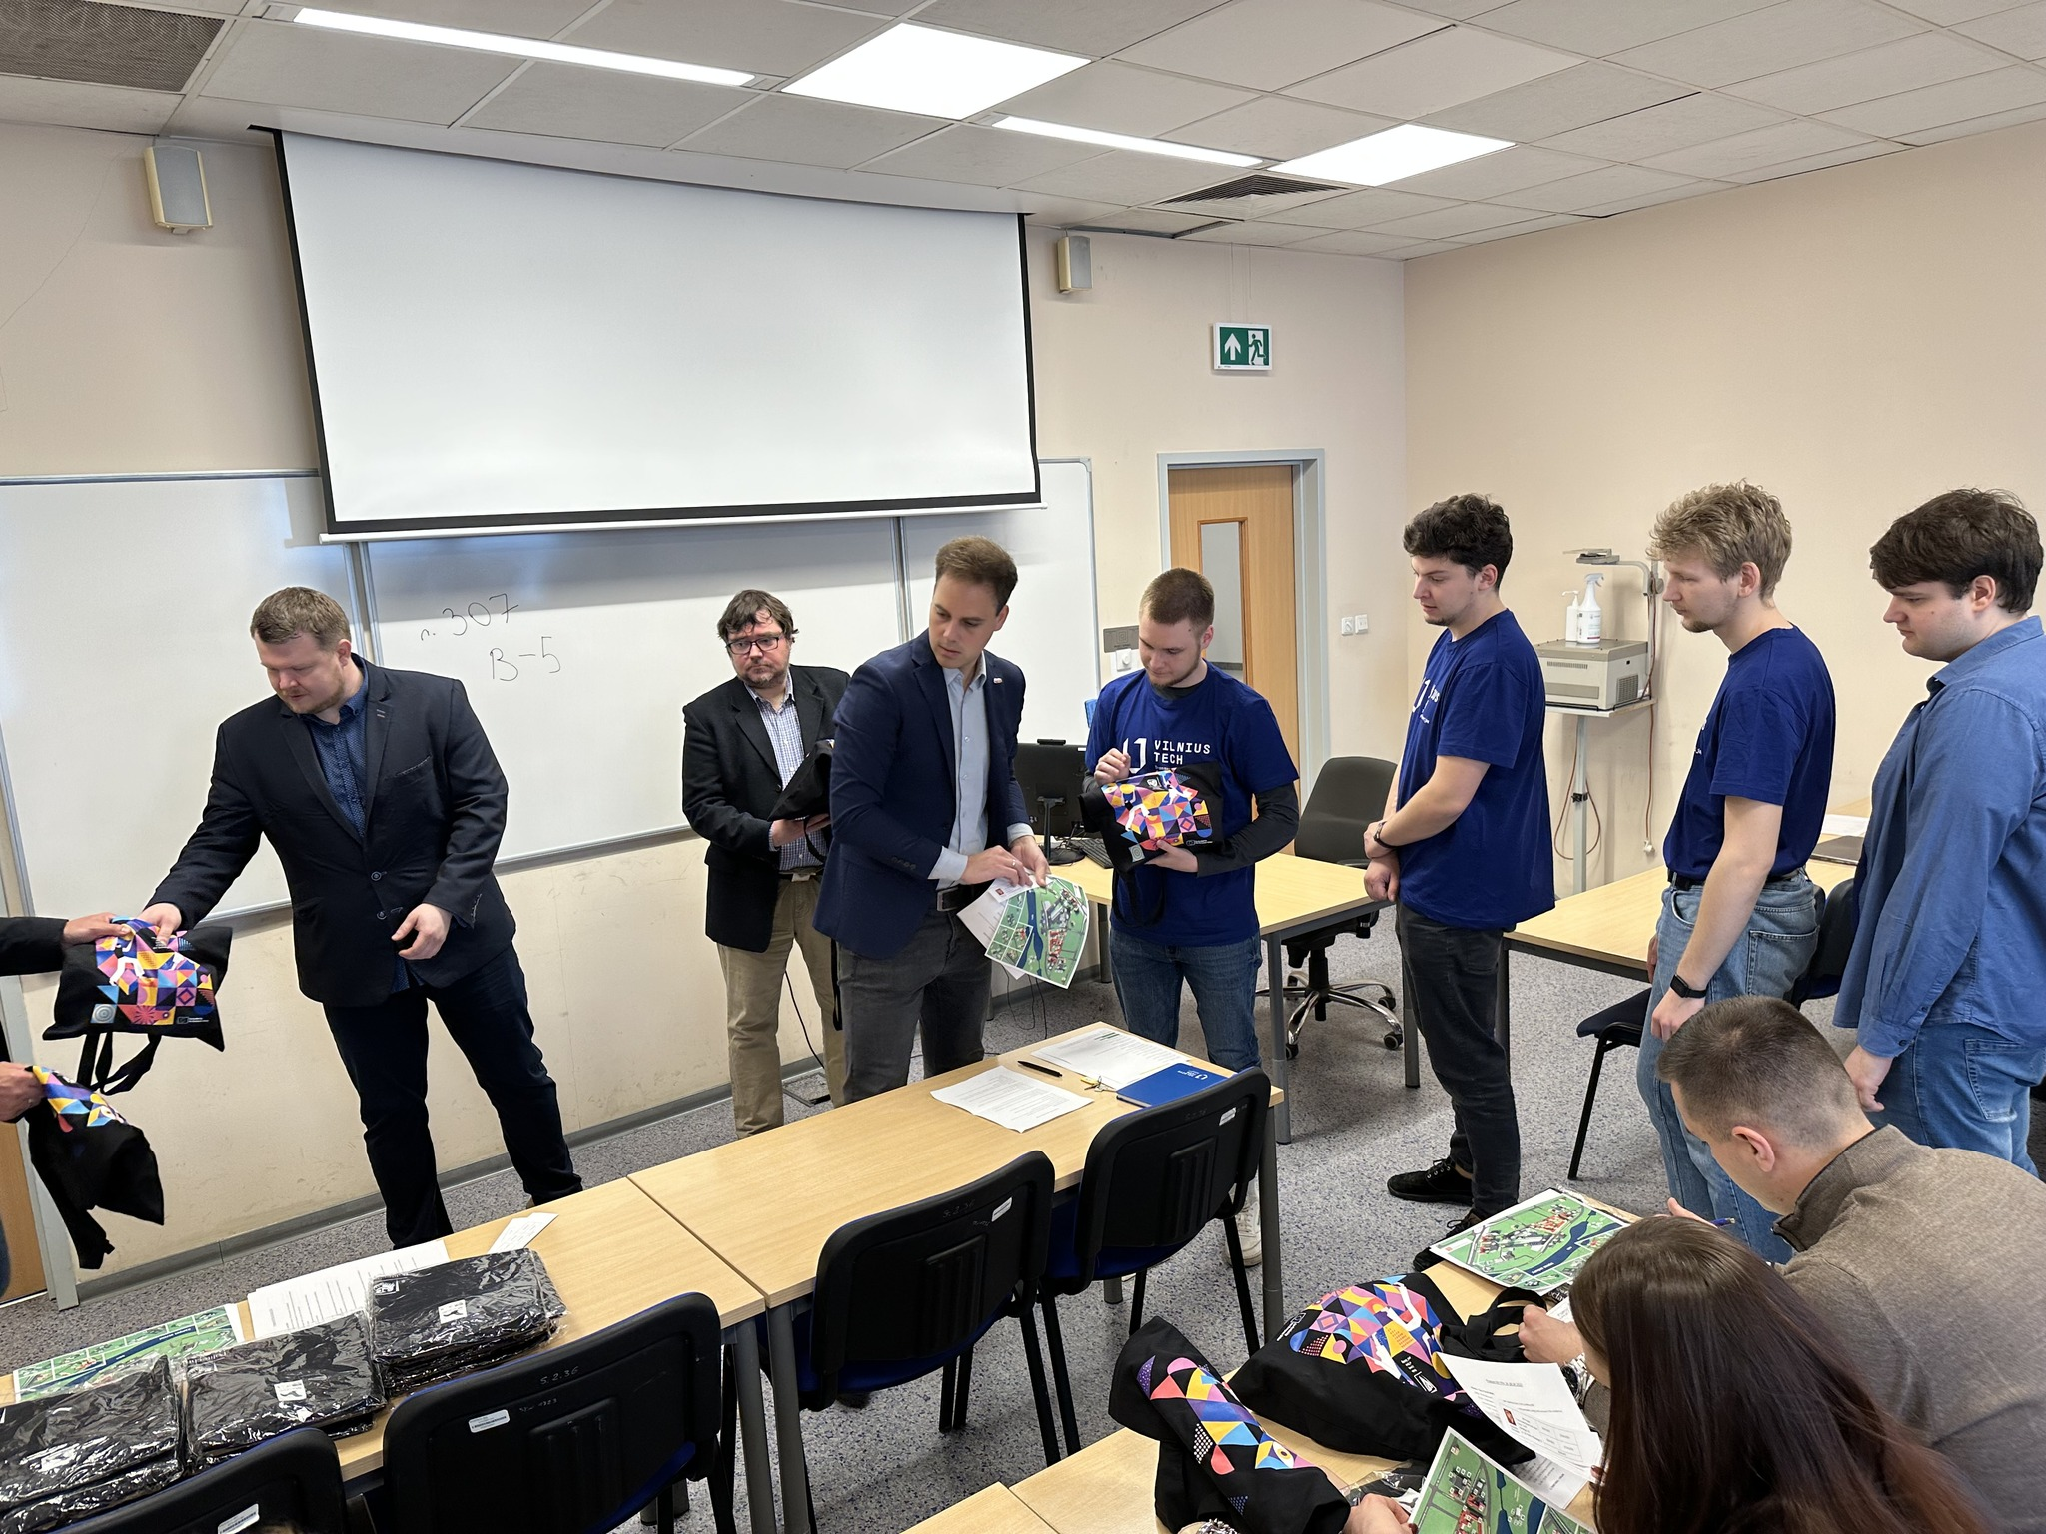
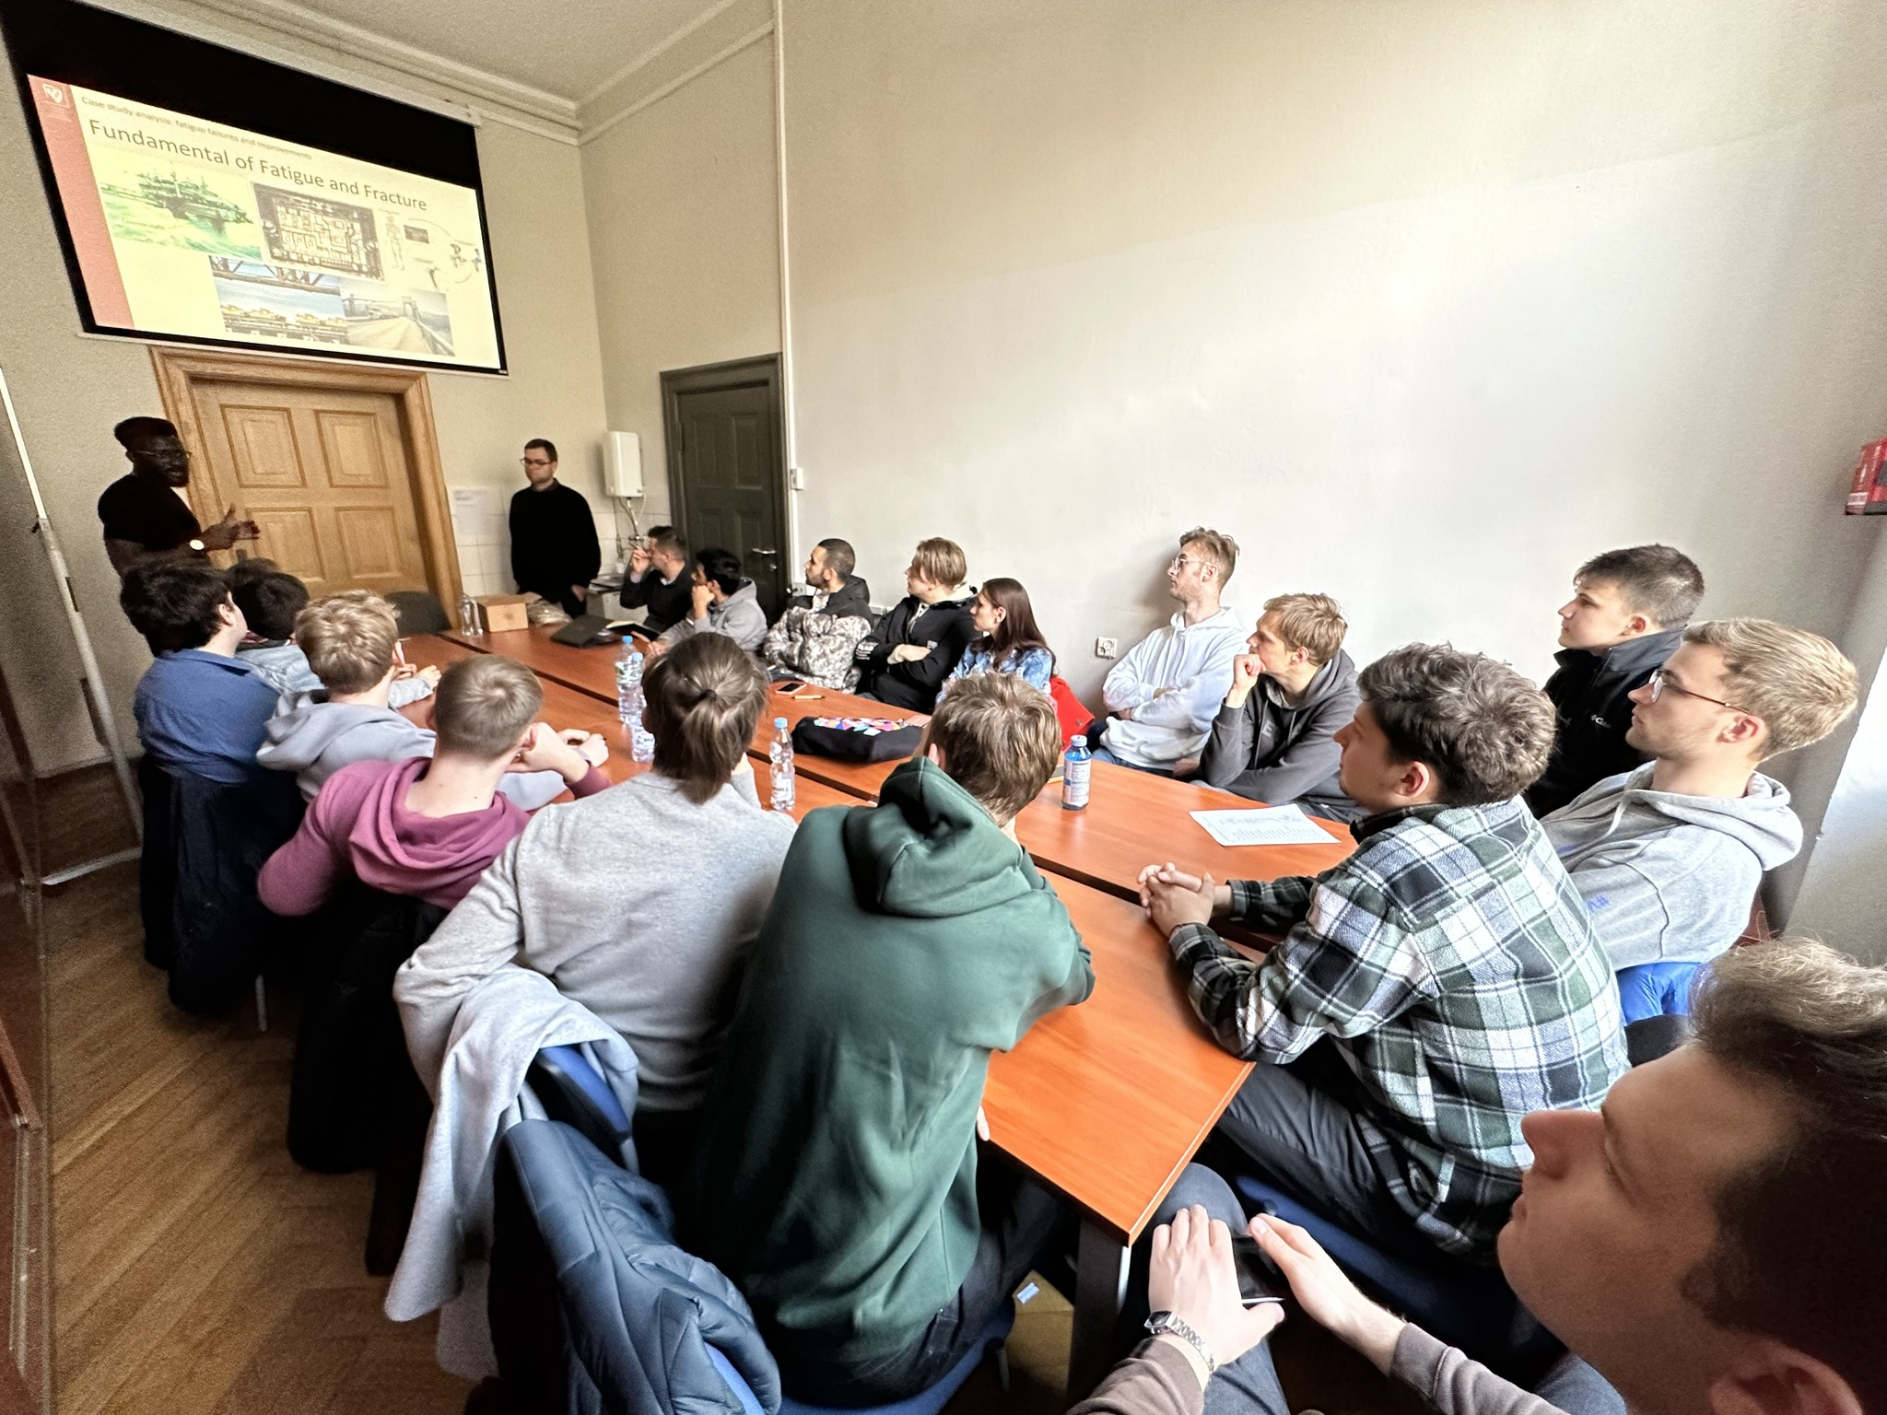
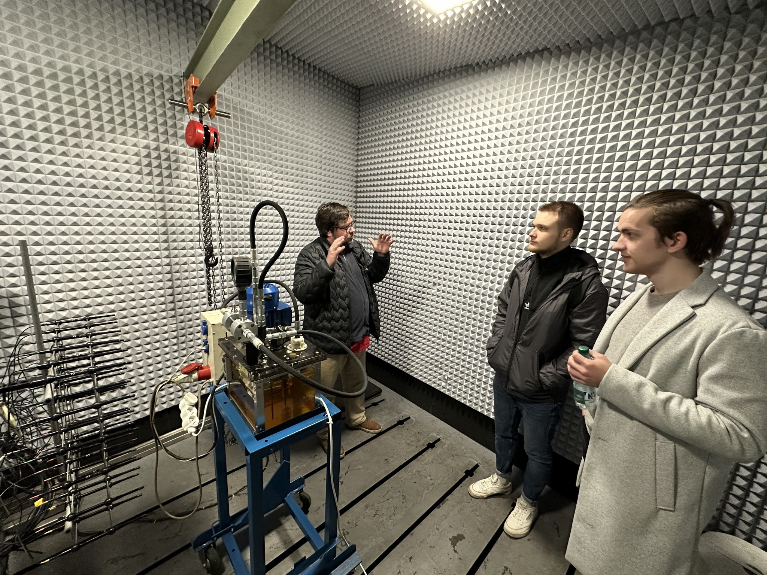
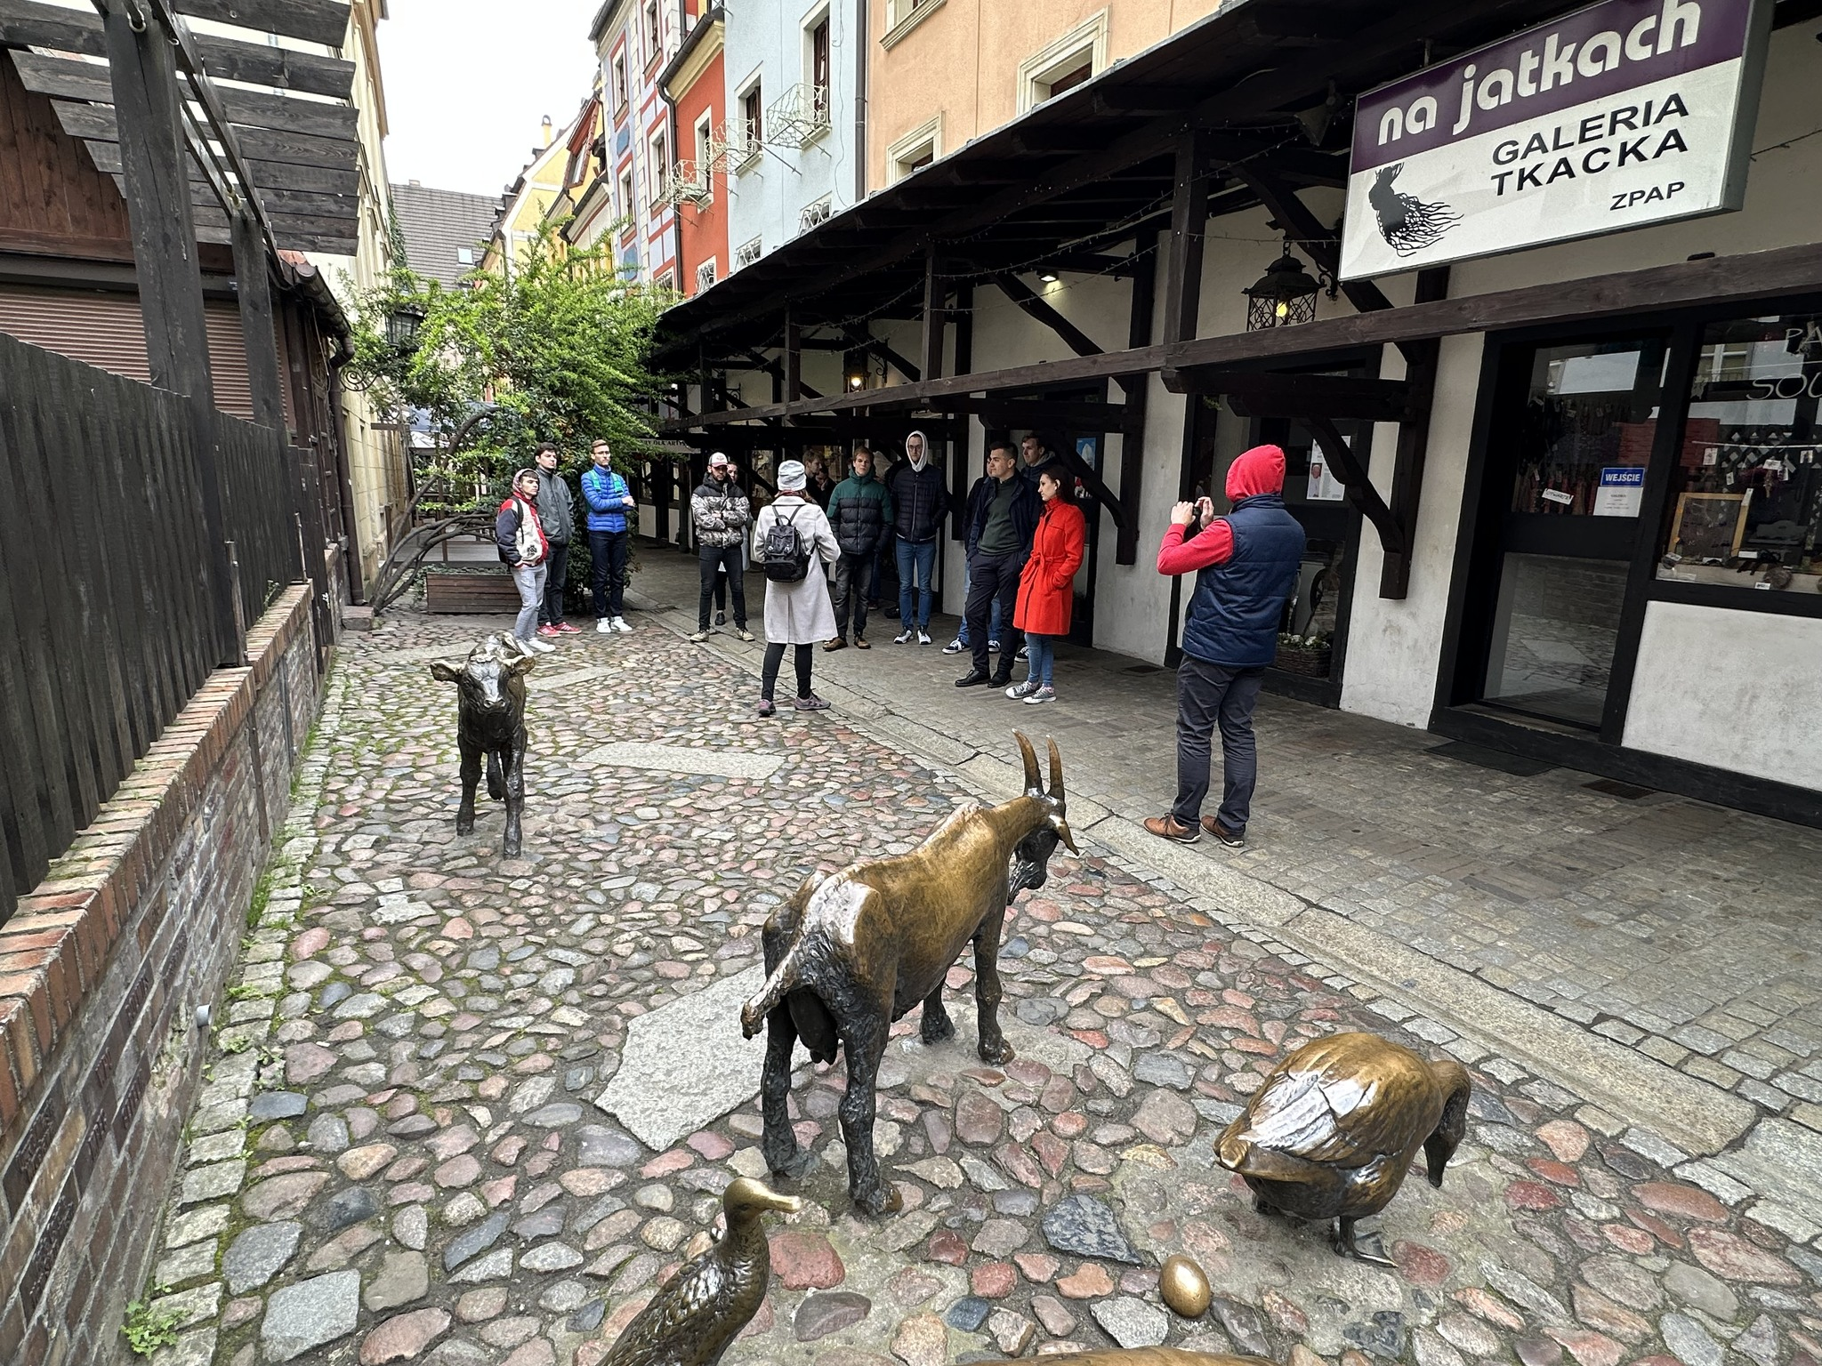

Slide 27

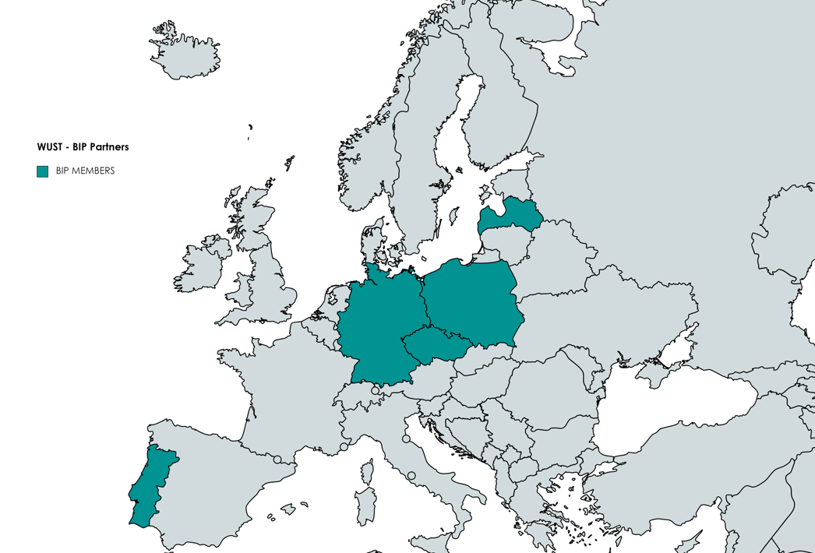






WUST –BIP EXPERIENCE
5 countries, in total: 23 Participants (11 origin countries)
The Brandenburg University of Technology Cottbus-Senftenberg
Riga Technical University
Brno University of Technology
University of Porto
Wroclaw University of Science and Technology

Slide 28
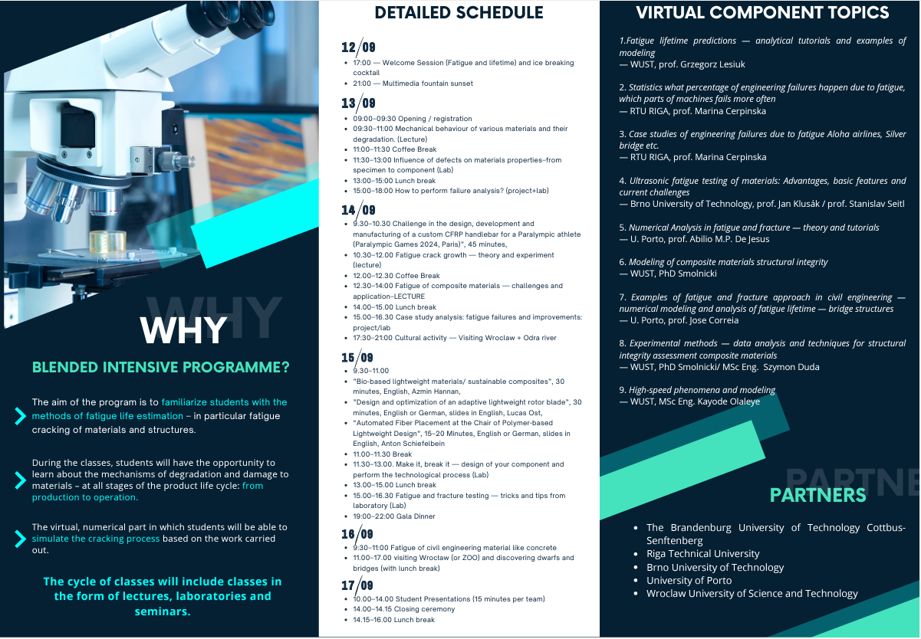
CONTENT: ON-SITE MEETING (WUST 12-17.IX.2023)
VIRTUAL COMPONENTS (UP TO END OF X.2023)

Slide 29
OBJECTIVES
The aim of the program was to familiarize Students with the methods of fatigue life estimation particularly in fatigue cracking of materials and structures. During the classes, students have had the opportunity to learn about the mechanisms of degradation and damage to materials – at all stages of the product life cycle: from production to operation.
Students were acquainted with research and diagnostic methods and will independently perform damage analyzes of various machine parts. In addition, an important aspect is (ongoing) the virtual, numerical part in which students will be able to simulate the cracking process based on the work carried out in WUST’s labs.

Slide 30
INVITED LECTURES FROM PARTNERS (IN WROCLAW)
TEAM FROM CZECH REPUBLIC:
  Fatigue of Civil engineering materials: Concrete and mortar – Prof. S. Seitl – Brno University of Technology.
  Mesoscale discrete model for monotonic, cyclic and fatigue loading of concrete - Prof. Miroslav Vořechovský – Brno University of Technology.
TEAM FROM GERMANY:
  Bio-based lightweight materials/ sustainable composites Azmin Hannan – BTU Cottbus.
  Design and optimization of an adaptive lightweight rotor blade, Lucas Ost, BTU Cottbus.

Slide 31
Non – traditional teaching fatigue analysis through FM-TOOL PLATFORM (COMPANY NOBO SOLUTIONS S.A.) and laboratory skills training (metals and composites)
  Multidisciplinary approach:
  the « global change for grand challenges » is motivating
  for team management
    Adequate for our « Top Industrial Managers in Engineering »
    Team Management
    Safety of structures / reliability
  Sustainable objectives
      Environmental and energy issues
        Optimization of structure and design
        Projects based on fatigue lifetime
      Social issues
Laboratory sessions for Students &
Training workshops from Structural Integrity
  Development of common PhD Theses – lab.
  working and data analysis in special sessions

Slide 32
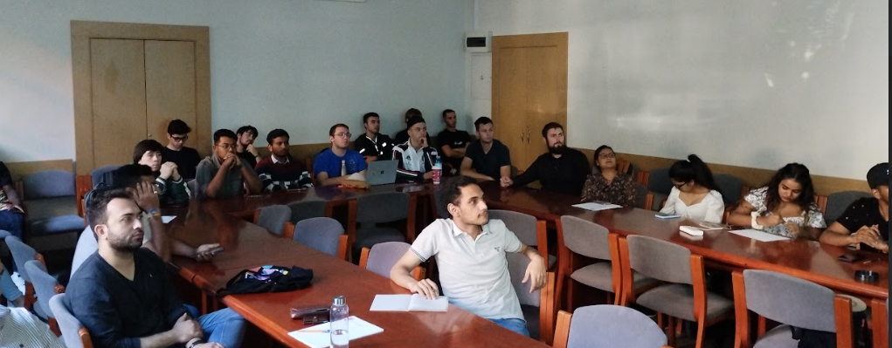
ADVANTAGES AND DISADVANTAGES
Excellent time slot (SEP) for performing huge number of laboratory activities
Interdisciplinary program – outside „classical” courses served by WUST and Partners
Brainstorming during final day – presentations of students projects
New possible common PhD projects
Different „scientific maturity” of students (need to update level of courses during meeting – solved by division for sub-groups for labs)
Difficulties with different academic year system…
Recognition of courses in ECTS credits
Relatively low level of global recognition BIP program ?
Organization of labs - no of students in one BIP - necessary division of students - different skills, different levels…

Slide 33
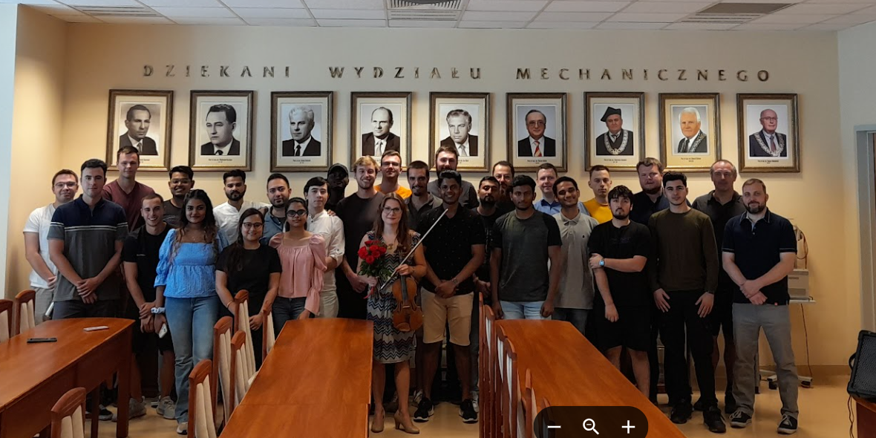
CULTURAL ACTIVITY
(NOT LIMITED TO SCIENTIFIC – DIDACTIC DEVELOPMENT)
- MEETING WITH CLASSICAL MUSIC CONCERT

Slide 34
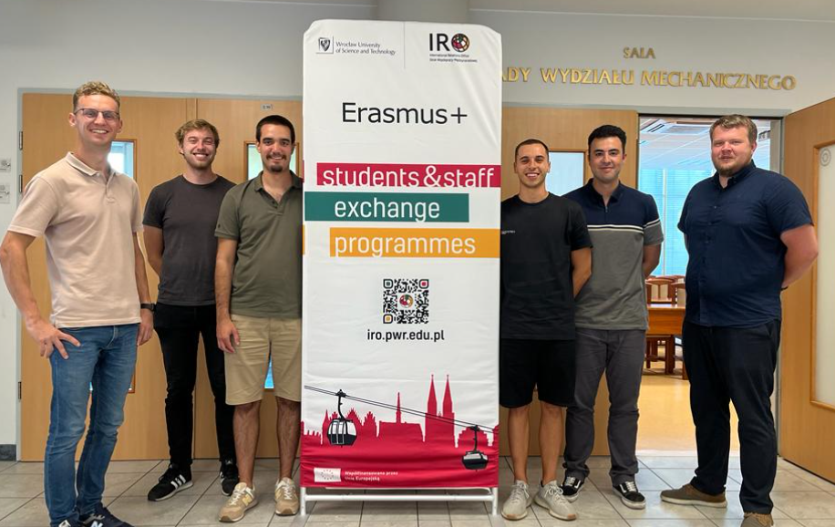
PROJECT OUTCOMES – COMMON PHD STUDENTS (WUST+UPorto) TRAINING

Slide 35
Schedule
  Concept of BIPs
  Case Study from Wrocław University of Science and Technology
  Discussion
  Final conclusions

Slide 36
Conclusions
  An opportunity to exchange and improve teaching activities between
  institutions (UNITE, T.I.M.E. network, European universities, …)
  Intensive : each institution shares an expertise; Blended : much more
  than one or two weeks with virtual component;
  Programme : capitalizes efforts
  Should be combined with other incomes (Erasmus Staff mobility, ...)
  Stay reasonable to satisfy the constraints (#HEI=3, #students ~20)
  Promoter = receiving institution : validated.

